Slide 1
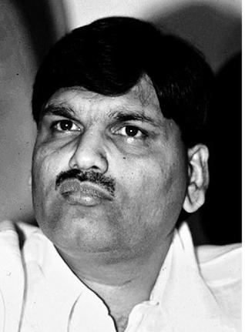
Harshad Mehta Scam
The Man who shook the Nation !
Presented BY,
Kalyani sananse
Gokarni sarode
Pankaj sen
Sawan Salunke

Slide 2
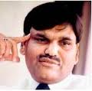
Harshad Mehta
Name: Harshad Shantilal Mehta
Born in: 29 July 1953
Died in: 31 December 2001
Profession: stockbroker
He earned degree in bachelor of commerce
Started his working life as an employee of the new India assurance company

Slide 3
Economic & Market position before the scam
Licensing System
No Permission For Liberalization, Privatization, Globalization
Government Intervention In Business
There Were No Permission For Fii’s & Fdi’s
There Was Not Specific Act Passed For SEBI By The Parliament
Open-outcry System
No Circuit Breakers

Slide 4
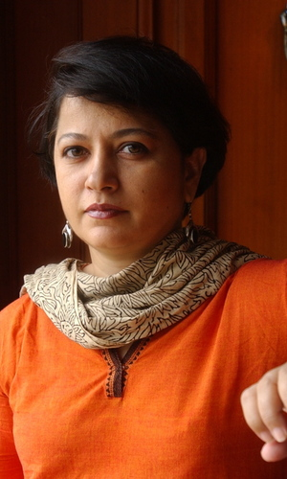
Exposure of 1992 Securities Scam
On April 23, 1992, journalist Sucheta Dalal exposed Mehta's scam
She is columnist in Times Of India
Sucheta Dalal

Slide 5
The Instruments were used in Scam
Mehta had used 2 instruments in this scam
1)Ready Forward Deal
2)Bank Receipts

Slide 6
Ready Forward Deal
A secured short-term (typically 15-day) loan from one bank to another
Bank lends against government securities
A broker usually brings together two banks for which he is paid a commission
The securities and payments were delivered through the broker in the settlement process
In such settlement the banks may not know with whom they are dealing

Slide 7
Bank Receipts
In a RF deal securities were not moved back and forth in actuality
The borrower, i.e. The seller of securities, gave the buyer of the securities a bank receipt
Bank receipts serve three functions
1) confirms the sale of securities
2) states that the securities are held by the seller in trust for the buyer
3) acts as a receipt for the received money by the selling bank
In this scam bank of karad & metropolitan co-operative bank had issued fake BR

Slide 8
Regulatory Actions Taken Against Mehta
He was later charged with 72 criminal offenses, and more than 600 civil action suits were filed against him
He was arrested and banished from the stock market
Mehta and his brothers were arrested by the CBI on November 9, 1992 for allegedly misappropriating more than 27 lakh shares of about 90 companies

Slide 9
Conclusion
Harshad Mehta was brave stock broker. He knew the loopholes in banking system as well as how to exploit that loopholes. His whole intension to do this was to rise in SENSEX. He was tried for 9 years and of the 27 criminal charges brought against him, he was only convicted of one, before his death at age 47 in 2001

Slide 10
Thank You…!!!

